Slide 1

What is Data?
Collection of data objects and their attributes
An attribute is a property or characteristic of an object
  Examples: eye color of a person, temperature, etc.
  Attribute is also known as variable, field, characteristic, or feature
A collection of attributes describe an object
  Object is also known as record, point, case, sample, entity, or instance
Attributes
Objects

Slide 2
Types of attributes ….
Nominal:
  items differentiated by a simple naming system
  They may have numbers assigned to them. But, they are not actual numbers. They simply capture and reference.
  They are ‘categorical’ i.e, they belong to a definable category.
  Ex:- ID numbers, eye color, zip codes

Slide 3
Types of attributes…
2) Ordinal:
  They have some kind of order by their position on the scale.
  order of items can be defined by assigning numbers – relative position.
  letters can also be assigned.
  they are ‘categorical’
  cannot do arithmetic – only ordering property.
  Ex:
    rankings (taste of potato chips on a scale from 1 – 10)
    Grades in {A, B, C, D, E}
    Height in {small, medium, large}

Slide 4
Types of attributes ….
3) Interval:
    Is measured along a scale in which each position is
    equidistant from one another.
    Distance between two pairs will be equivalent in some way.
    Cannot be multiplied, or divided.
    Ex:
    Calendar dates
    Temperature in celsius/fah

Slide 5
Types of attributes….
4) Ratio
numbers can be compared as multiples of one another.
One person can be twice as tall as another person
Number zero has no meaning
Ex:
Difference between a person of age 35 and a person of age 38 is same as difference between people who are 12 and 15.
Ratio data can be multiplied and divided.

Slide 6
Types of attributes…
Interval and ratio data measure quantities and hence are quantitative.
Ex: length, time, count

Slide 7
Types of attributes…
Nominal (symbolic, categorical)
  Values from an unordered set
  Ex: {red, yellow, blue, ….}
Ordinal :
  Values from an ordered set
  Ex: {good, better, best}
Continuous : real numbers
  Ex: {-9.8, 3.9,…..}

Slide 8
Discrete and Continuous Attributes
Depending on the number of values :-
Discrete Attribute
  Has only a finite or countably infinite set of values
  Examples: zip codes, counts, or the set of words in a collection of documents
  Often represented as integer variables.
  Note: binary attributes are a special case of discrete attributes
Continuous Attribute
  Has real numbers as attribute values
  Examples: temperature, height, or weight.
  Practically, real values can only be measured and represented using a finite number of digits.
  Continuous attributes are typically represented as floating-point variables.

Slide 9


Types of Attributes Summary
There are different types of attributes
  Nominal
    Examples: ID numbers, eye color, zip codes
  Ordinal
    Examples: rankings (e.g., taste of potato chips on a scale from 1-10), grades, height in {tall, medium, short}
  Interval
    Examples: calendar dates, temperatures in Celsius or Fahrenheit.
  Ratio
    Examples: temperature in Kelvin, length, time, counts

Slide 10
Properties of Attribute Values
The type of an attribute depends on which of the following properties it possesses:
  Distinctness: = ≠
  Order: < >
  Addition: + -
  Multiplication: * /
  Nominal attribute: distinctness
  Ordinal attribute: distinctness & order
  Interval attribute: distinctness, order & addition
  Ratio attribute: all 4 properties

Slide 11
Attribute Type
Description
Examples
Operations
Nominal
The values of a nominal attribute are just different names, i.e., nominal attributes provide only enough information to distinguish one object from another. (=, ≠)
zip codes, employee ID numbers, eye color, sex: {male, female}
mode, entropy, contingency correlation, χ² test
Ordinal
The values of an ordinal attribute provide enough information to order objects. (<, >)
hardness of minerals, {good, better, best},
grades, street numbers
median, percentiles, rank correlation, run tests, sign tests
Interval
For interval attributes, the differences between values are meaningful, i.e., a unit of measurement exists.
(+, - )
calendar dates, temperature in Celsius or Fahrenheit
mean, standard deviation, Pearson's correlation, t and F tests
Ratio
For ratio variables, both differences and ratios are meaningful. (*, /)
temperature in Kelvin, monetary quantities, counts, age, mass, length, electrical current
geometric mean, harmonic mean, percent variation

Slide 12
Types of Attributes Summary
Classify the following attributes as :-
binary, discrete or continuous
Qualitative(nominal or ordinal) or quantitative (interval or ratio)
Age in years
  Ans: discrete, quantitative, ratio
2) Brightness as measured by a light meter
  Ans: continuous, quantitative, ratio
3) Bronze, silver and gold medals as awarded at Olympics
  Ans: Discrete, qualitative, ordinal.

Slide 13
Types of data sets
Record
  Data Matrix
  Document Data
  Transaction Data
Graph
  World Wide Web
  Molecular Structures
Ordered
  Spatial Data
  Temporal Data
  Sequential Data
  Genetic Sequence Data

Slide 14
Record Data
Data that consists of a collection of records, each of which consists of a fixed set of attributes

Slide 15
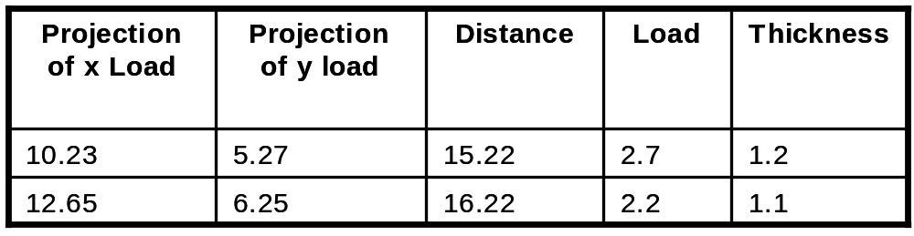
Data Matrix
If data objects have the same fixed set of numeric attributes, then the data objects can be thought of as points in a multi-dimensional space, where each dimension represents a distinct attribute
Such data set can be represented by an m by n matrix, where there are m rows, one for each object, and n columns, one for each attribute

Slide 16

Document Data
Each document becomes a `term' vector,
  each term is a component (attribute) of the vector,
  the value of each component is the number of times the corresponding term occurs in the document.

Slide 17

Transaction Data
A special type of record data, where
  each record (transaction) involves a set of items.
  For example, consider a grocery store. The set of products purchased by a customer during one shopping trip constitute a transaction, while the individual products that were purchased are the items.

Slide 18
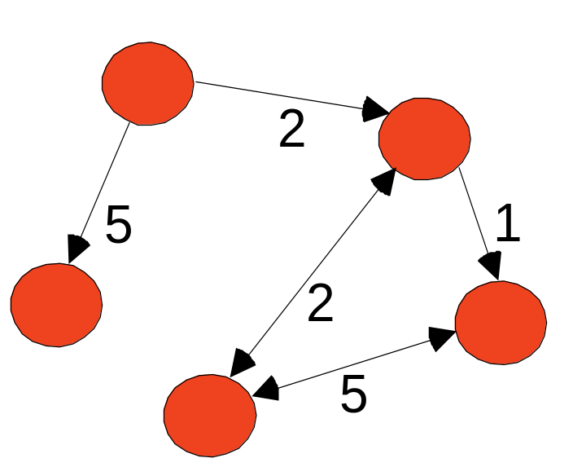
Graph Data
Examples: Generic graph and HTML Links
a graph is sometimes a more
convenient and powerful representation of data
can be used to capture relationship between data objects.
Data objects themselves can be graphs.
Ex: set of linked web pages can be represented as graphs

Slide 19
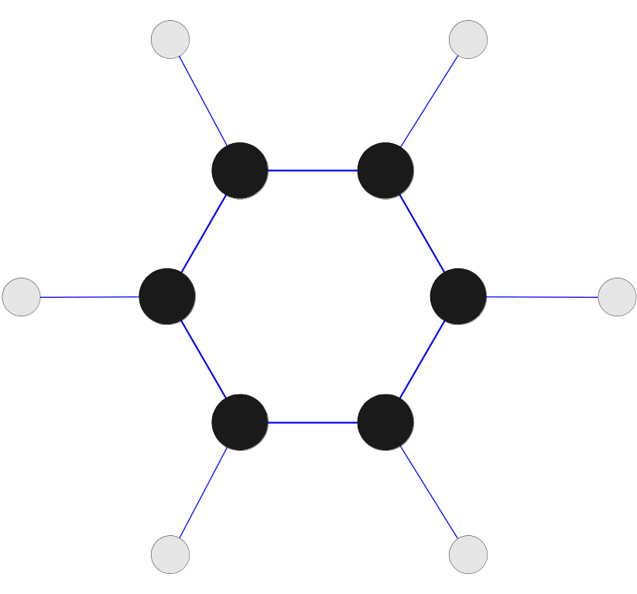
Chemical Data as a Graph
Data with objects that are graphs:-
Objects have sub-objects that have relationships
Ex : structure of chemical compounds
Nodes – atoms
Links – chemical compounds
Benzene Molecule: C₆H₆
Mining Substructures
Which substructures occur frequently
in a chemical compound?
Is the presence of any substructure
associated with any other?

Slide 20
Ordered Data
Attributes have relationships that involve order in time/space
Extension of a record data
Each record has a time associated with it
Each attribute can also be given a time stamp.

Slide 21
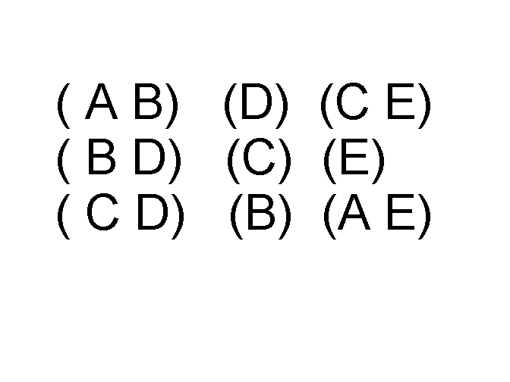
Ordered Data
Sequences of transactions
Items/Events
Patterns ?
People who buy DVD player tend to buy DVDs in the period immediately following the purchase of DVD player.
An element of the sequence

Slide 22
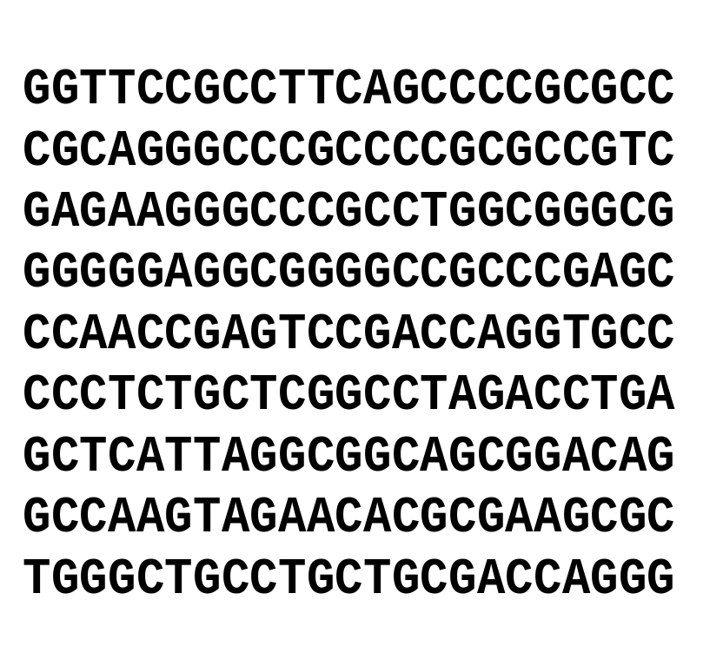
Ordered Data
Genomic sequence data – sequences of individual entities, letters/words. No time stamp
Ex: genetic info of animals/plants in the form of sequences of genes/nucleotides.
Human genetic code sequence- 4 genes : A, T, G and C.
Mining on gene data – capture structure and properties of genes
Mining biological sequence data - BIOINFORMATICS

Slide 23
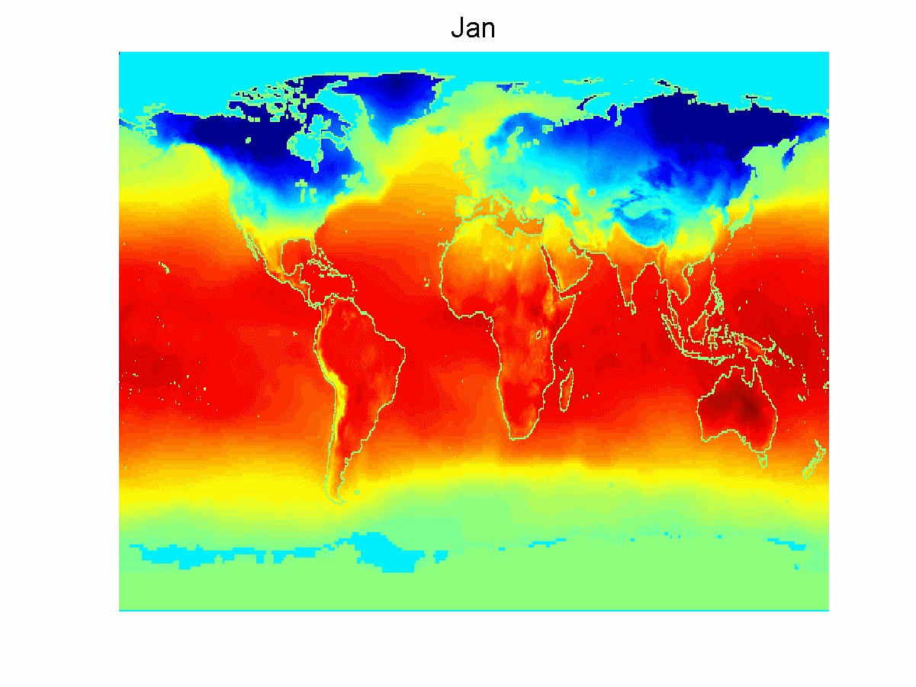
Ordered Data
Spatio-Temporal
Data
Spatial attributes
– position and area
Ex: weather data
Earth sciences data
- measures temp
and pressure
measured at points
on latitude - longitude
Average Monthly Temperature of land and ocean

Slide 24
Time-series data
A special type of sequential data
Each record is a time-series i.e. a series of measurements taken over time
Ex: financial data set has objects which are the time series of the daily prices of various stocks.
Have temporal autocorrelation
If two measurements are close in time, then their values are often similar.

Slide 25
Data Quality
First step – detect and correct data quality problems – data cleaning/preparation/pre-processing
What kinds of data quality problems?
How can we detect problems with the data?
What can we do about these problems?
Examples of data quality problems:
  Noise and outliers
  missing values
  duplicate data

Slide 26


Noise
Noise refers to modification of original values
  Examples: distortion of a person’s voice when talking on a poor phone and “snow” on television screen
Two Sine Waves
Two Sine Waves + Noise

Slide 27

Outliers
Outliers are data objects with characteristics that are considerably different than most of the other data objects in the data set

Slide 28
Missing Values
Reasons for missing values
  Information is not collected
  (e.g., people decline to give their age and weight)
  Attributes may not be applicable to all cases
  (e.g., annual income is not applicable to children)
Handling missing values
  Eliminate Data Objects
  Estimate Missing Values
  Ignore the Missing Value During Analysis
  Replace with all possible values (weighted by their probabilities)

Slide 29
Duplicate Data
Data set may include data objects that are duplicates, or almost duplicates of one another
  Major issue when merging data from heterogenous sources
Examples:
  Same person with multiple email addresses
Data cleaning
  Process of dealing with duplicate data issues

Slide 30
Why Data Pre-processing?
Heterogeneous data – data integration
  from various departments in various forms
Dirty data – data cleaning
  Incomplete data : missing attribute values
  Ex: occupation = “”
Noisy data : containing errors
  Ex: salary = “-10”
Discrepancies in codes or names
  Ex: US = USA
Data not in the right format – data transformation
  Normalization, discretization, etc
A huge amount of data – data reduction
  Speed up mining

Slide 31
Why Data Pre-processing?
No quality data, no quality mining results.
Some data preparation is needed for all mining tools.
Purpose of preparation is to transform the data sets so that their info content is best exposed to the mining tool.
Error in prediction rate should be lower
(or same) after preparation as before it
Data miner to produce better models faster.

Slide 32
Major Tasks in Pre-processing
Data Integration
  Integration of multiple databases or files
Data Cleaning
  Fill in missing values, identify outliers, smooth out noisy data, and resolve discrepancies
Data Transformation
  Feed right data to the mining algorithm
Data Reduction
  Obtains reduced representation in volume but produces the same analytical results.
Data Discretization
  Part of data reduction and data transformation.
  It transforms numerical data into symbolic(discrete) data.

Slide 33
Data Integration
Data Integration:
  Combines data from multiple sources into a coherent store
Schema Integration
  Integrate meta data from different sources
Detecting and resolving data value conflicts
  For the same real world entity, attribute values from different sources are different
  Possible reasons: different representations, different scales
  Eg, hotel price in different currencies, metric vs. British units
  Eg was rating “1,2,3” now rating “A, B, C”

Slide 34
Data Cleaning
Why is data dirty?
  Incomplete data come from
    Human/hardware/software problems (device malfunction)
    Different consideration between the time when data was collected and when it is analyzed.
      Certain data may not be considered important at the time of entry.
Noisy data come from the process of
  Data collection
  Data entry
  Data transmission
Data Cleaning tasks
  Fill in missing values
  Identify outliers and smooth out noisy data

Slide 35
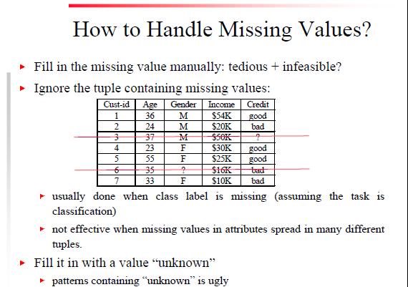

Slide 36
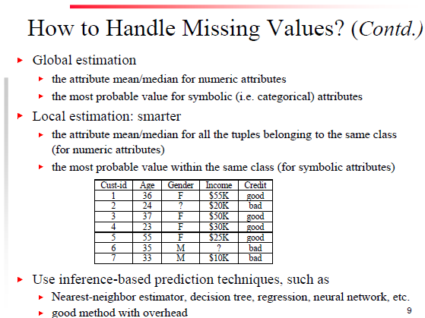

Slide 37
Data Transformation
Discretization
  Supervised
    Entropy – based
  Unsupervised
    Equal width and equal frequency
Normalization
  Min-max
  Z-score
  Decimal scaling
Binarization

Slide 38
Discretization/Quantization
Three types of attributes:
  Nominal – values from an unordered set
  Ordinal – values from an ordered set
  Continuous – real numbers
Discretization :
  Divide the range of a continuous attribute into intervals
  Some classification algos only accept categorical attributes
  Reduce data size by discretization
  Prepare for further analysis

Slide 39
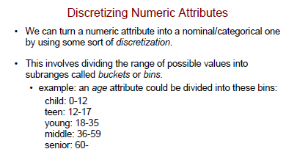
Transformation by Discretization
Some Algorithms require nominal/ discrete attributes

Slide 40
Discretization methods
Unsupervised
  Independent of the class label
  Ex: Equal width binning, equal frequency binning
Supervised
  Dependent on the class label
  Ex: entropy based binning

Slide 41
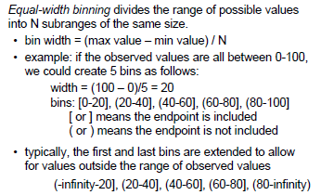
Unsupervised Discretization

Slide 42
Equal Width binning…
Advantages :
  Simple and easy to implement
  Produce a reasonable abstraction of data
Disadvantages :
  Unsupervised
  Where does N come from?
  If there are many occurrences of one range in the data set, it would be useless for the data mining task.

Slide 43
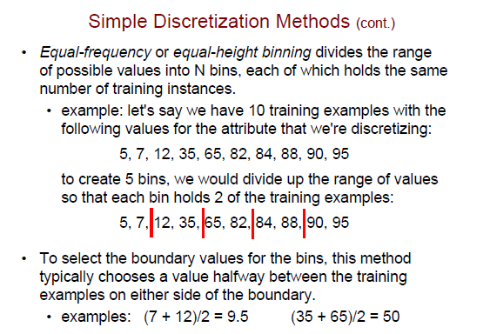

Slide 44
Equal – frequency ….
Disadvantages :
Additional considerations
  Create separate bins for zeros
  Round the break points – readable.

Slide 45
Entropy Based Discretization- Supervised
Uses the class info present in the data
Entropy(info content) is calculated based on the class label
Tries to find the best split so that bins are as pure as possible.
Pure bin : majority of the values in a bin should correspond to the same class.
Purity of a bin is measured using its entropy
Entropy
  Zero – perfectly pure bin
  Max (1) – impure – equal class distribution

Slide 46
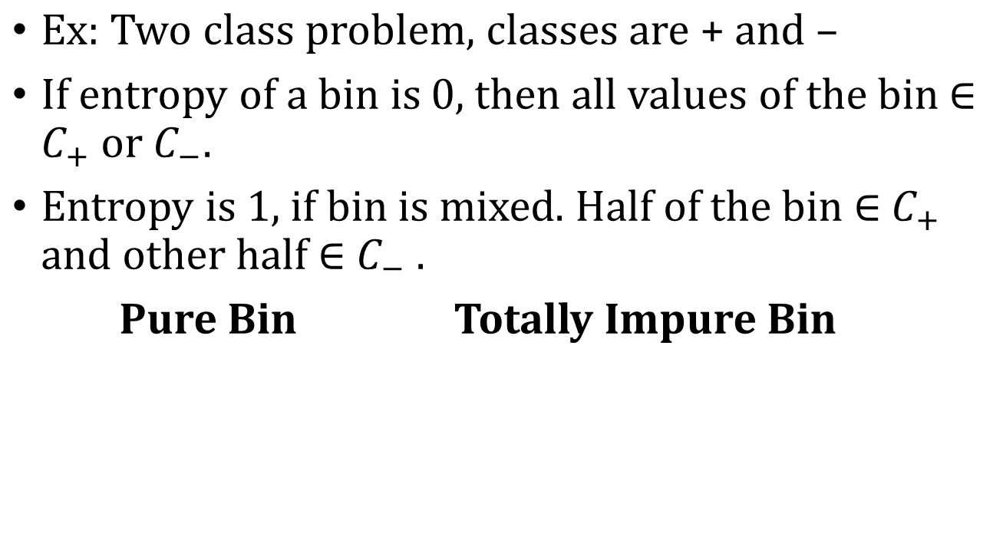
Entropy Based Discretization- Supervised…
15 7
+ + +
6 13 7
+ - - +

Slide 47
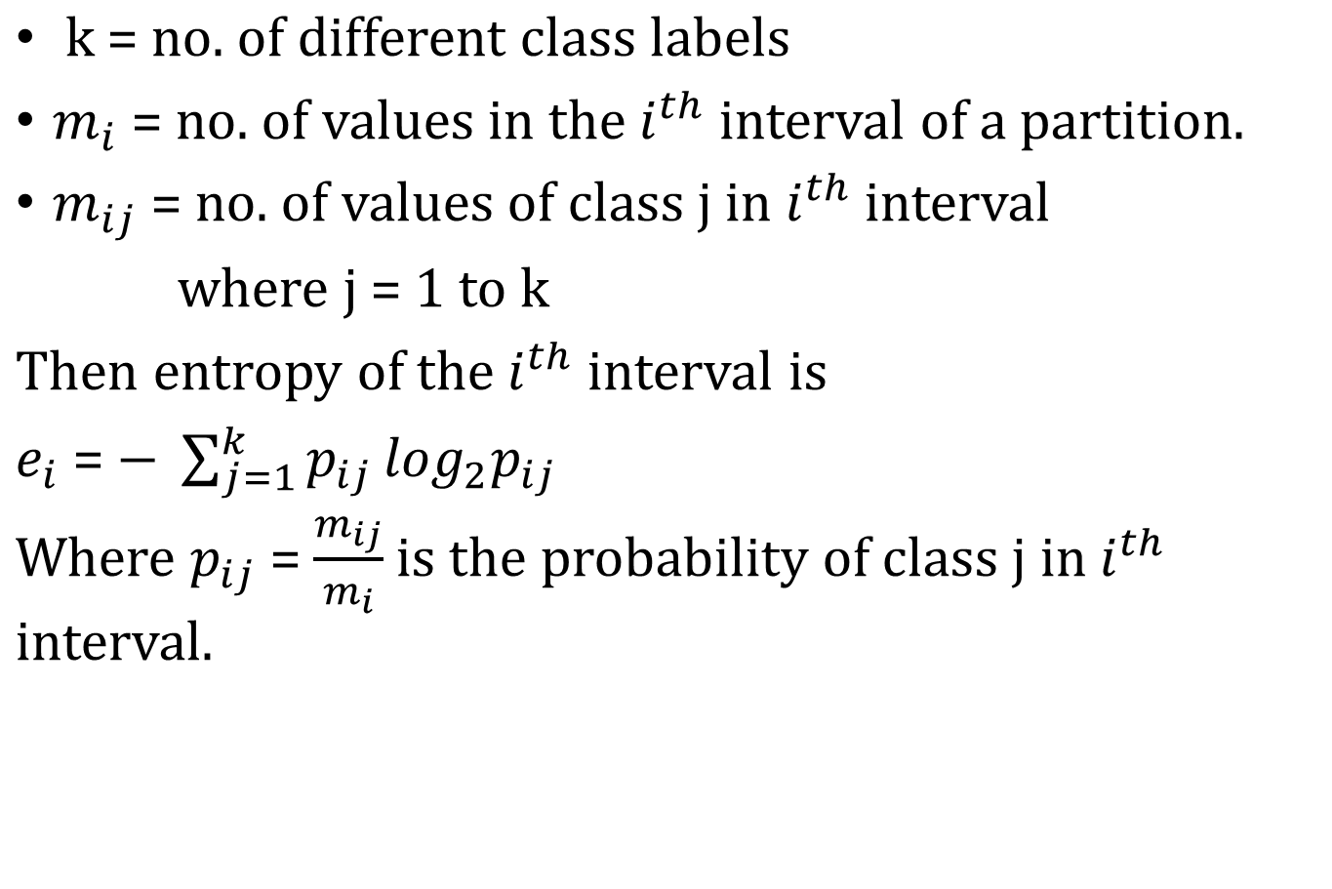
Entropy

Slide 48
Procedure…
Sort the attb values to be discretized, S
Bisect the initial values so that the resulting two intervals have minimum entropy.
  Consider each value T as a possible split point Where T = midpoint of each consecutive attb values.
  Compute the information gain before and after choosing T as a split point.
  Gain = E(S) – E(T,S)
  Select the best T which gives the highest info gain as the optimum split.

Slide 49
3. Repeat step 2 with another interval (highest entropy) until a user specified no. of intervals is reached or some stopping criterion is met.

Slide 50
Thank You
CSE-307-Data Mining

